Slide 1
Apache Karaf Cellar and Fuse Fabric
Ioannis Canellos
Camel One – May 2012

Slide 2
Your Speaker
Ioannis Canellos
iocanel@fusesource.com
Blog: http://iocanel.blogspot.com
Software Architect @ FuseSource
Open Source Contributor
Apache Karaf
Apache ServiceMix
Apache Camel
Apache Whirr
Jclouds
Founder of Apache Karaf Cellar
Notes:
We have a sales and marketing engine that is very similar to
Primarily a telesales based organization. We use the web as a conduit to provide all of the resources needed for customers to investigate and do a POC. The types of offers we provide range from free items like webinars, code examples, documentation, through things that they can pay for like virtual instructor led course, healthcheck, development support subscription and deployment subscription. We make our money on the subscription. What is the pricing model for your subscription? We price by the machine it is like a CPU based pricing. Would a standard be a dual core or quad core. You can buy a subscription for $10K for CPU or $20K for dual core. We also have discount pricing and we have developer pricing which is 8X5 and access to developer and training. We charge by the seat in that model, costs about $5K. Have you compared cost of Fuse versus commercial software. Depends on the number of years you run the model. Year one you are talking about 25-30% of the cost versus a commercially licensed ESB. That is no different than any of the other open source categories that have emerged. Certain industries are cost sensitive like retail and government who are big early adopters of open source – they view IT as a cost center. We are providing pedestrian pricing for pedestrian applications. Are you bottom feeding? No these companies are looking for the best of both worlds. They are looking for software that works at a low price where they can get big company help when they need it. We tend to focus on the cool, strategic, sexy apps as industry insiders, but most of the business is in the middle. These projects are very mature, 1000s of apps built on them. What’s the ballpark of subscription $30-50K taking out the outliers. There are some very big ones, there numbers are huge too. We have 200 customers, subscription customers probably closer to 75. we had 135% topline growth last year. This model works if you have a large, thriving open source community underlying it. In this case we do.

Slide 3
Agenda
Managing distributed OSGi Runtimes
Apache Karaf Cellar
Fuse Fabric
Questions & Answers
Notes:
We have a sales and marketing engine that is very similar to
Primarily a telesales based organization. We use the web as a conduit to provide all of the resources needed for customers to investigate and do a POC. The types of offers we provide range from free items like webinars, code examples, documentation, through things that they can pay for like virtual instructor led course, healthcheck, development support subscription and deployment subscription. We make our money on the subscription. What is the pricing model for your subscription? We price by the machine it is like a CPU based pricing. Would a standard be a dual core or quad core. You can buy a subscription for $10K for CPU or $20K for dual core. We also have discount pricing and we have developer pricing which is 8X5 and access to developer and training. We charge by the seat in that model, costs about $5K. Have you compared cost of Fuse versus commercial software. Depends on the number of years you run the model. Year one you are talking about 25-30% of the cost versus a commercially licensed ESB. That is no different than any of the other open source categories that have emerged. Certain industries are cost sensitive like retail and government who are big early adopters of open source – they view IT as a cost center. We are providing pedestrian pricing for pedestrian applications. Are you bottom feeding? No these companies are looking for the best of both worlds. They are looking for software that works at a low price where they can get big company help when they need it. We tend to focus on the cool, strategic, sexy apps as industry insiders, but most of the business is in the middle. These projects are very mature, 1000s of apps built on them. What’s the ballpark of subscription $30-50K taking out the outliers. There are some very big ones, there numbers are huge too. We have 200 customers, subscription customers probably closer to 75. we had 135% topline growth last year. This model works if you have a large, thriving open source community underlying it. In this case we do.

Slide 4
Agenda
Managing distributed OSGi Runtimes
Apache Karaf Cellar
Fuse Fabric
Questions & Answers
Notes:
We have a sales and marketing engine that is very similar to
Primarily a telesales based organization. We use the web as a conduit to provide all of the resources needed for customers to investigate and do a POC. The types of offers we provide range from free items like webinars, code examples, documentation, through things that they can pay for like virtual instructor led course, healthcheck, development support subscription and deployment subscription. We make our money on the subscription. What is the pricing model for your subscription? We price by the machine it is like a CPU based pricing. Would a standard be a dual core or quad core. You can buy a subscription for $10K for CPU or $20K for dual core. We also have discount pricing and we have developer pricing which is 8X5 and access to developer and training. We charge by the seat in that model, costs about $5K. Have you compared cost of Fuse versus commercial software. Depends on the number of years you run the model. Year one you are talking about 25-30% of the cost versus a commercially licensed ESB. That is no different than any of the other open source categories that have emerged. Certain industries are cost sensitive like retail and government who are big early adopters of open source – they view IT as a cost center. We are providing pedestrian pricing for pedestrian applications. Are you bottom feeding? No these companies are looking for the best of both worlds. They are looking for software that works at a low price where they can get big company help when they need it. We tend to focus on the cool, strategic, sexy apps as industry insiders, but most of the business is in the middle. These projects are very mature, 1000s of apps built on them. What’s the ballpark of subscription $30-50K taking out the outliers. There are some very big ones, there numbers are huge too. We have 200 customers, subscription customers probably closer to 75. we had 135% topline growth last year. This model works if you have a large, thriving open source community underlying it. In this case we do.

Slide 5
Agenda
Managing distributed OSGi Runtimes
What is OSGi?
What makes OSGi really cool?
A new “challenge”
When OSGi cross the boundaries of a single runtime
Apache Karaf Cellar
Fuse Fabric
Questions & Answers
Notes:
We have a sales and marketing engine that is very similar to
Primarily a telesales based organization. We use the web as a conduit to provide all of the resources needed for customers to investigate and do a POC. The types of offers we provide range from free items like webinars, code examples, documentation, through things that they can pay for like virtual instructor led course, healthcheck, development support subscription and deployment subscription. We make our money on the subscription. What is the pricing model for your subscription? We price by the machine it is like a CPU based pricing. Would a standard be a dual core or quad core. You can buy a subscription for $10K for CPU or $20K for dual core. We also have discount pricing and we have developer pricing which is 8X5 and access to developer and training. We charge by the seat in that model, costs about $5K. Have you compared cost of Fuse versus commercial software. Depends on the number of years you run the model. Year one you are talking about 25-30% of the cost versus a commercially licensed ESB. That is no different than any of the other open source categories that have emerged. Certain industries are cost sensitive like retail and government who are big early adopters of open source – they view IT as a cost center. We are providing pedestrian pricing for pedestrian applications. Are you bottom feeding? No these companies are looking for the best of both worlds. They are looking for software that works at a low price where they can get big company help when they need it. We tend to focus on the cool, strategic, sexy apps as industry insiders, but most of the business is in the middle. These projects are very mature, 1000s of apps built on them. What’s the ballpark of subscription $30-50K taking out the outliers. There are some very big ones, there numbers are huge too. We have 200 customers, subscription customers probably closer to 75. we had 135% topline growth last year. This model works if you have a large, thriving open source community underlying it. In this case we do.

Slide 6
Managing distributed OSGi Runtimes: What is OSGi?
A set of standards
The missing modularity layer for the Java virtual machine
Additional layers for dynamic applications
Lifecycle layer
Service layer
Some core concepts
Bundle
A jar with well defined capabilities, requirements & content visibility
A jar with lifecycle
Service
An object usually implementing an interface + Properties
Registered, Looked Up & “Listened”
Notes:
We have a sales and marketing engine that is very similar to
Primarily a telesales based organization. We use the web as a conduit to provide all of the resources needed for customers to investigate and do a POC. The types of offers we provide range from free items like webinars, code examples, documentation, through things that they can pay for like virtual instructor led course, healthcheck, development support subscription and deployment subscription. We make our money on the subscription. What is the pricing model for your subscription? We price by the machine it is like a CPU based pricing. Would a standard be a dual core or quad core. You can buy a subscription for $10K for CPU or $20K for dual core. We also have discount pricing and we have developer pricing which is 8X5 and access to developer and training. We charge by the seat in that model, costs about $5K. Have you compared cost of Fuse versus commercial software. Depends on the number of years you run the model. Year one you are talking about 25-30% of the cost versus a commercially licensed ESB. That is no different than any of the other open source categories that have emerged. Certain industries are cost sensitive like retail and government who are big early adopters of open source – they view IT as a cost center. We are providing pedestrian pricing for pedestrian applications. Are you bottom feeding? No these companies are looking for the best of both worlds. They are looking for software that works at a low price where they can get big company help when they need it. We tend to focus on the cool, strategic, sexy apps as industry insiders, but most of the business is in the middle. These projects are very mature, 1000s of apps built on them. What’s the ballpark of subscription $30-50K taking out the outliers. There are some very big ones, there numbers are huge too. We have 200 customers, subscription customers probably closer to 75. we had 135% topline growth last year. This model works if you have a large, thriving open source community underlying it. In this case we do.

Slide 7
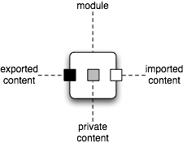
Managing distributed OSGi Runtimes: What is OSGi? (Bundles)
Bundle
Group of classes & resources
Content visibility metadata
Versioning of Classes
Multiple versions of Class
Importing with version ranges
Bundle Lifecycle
Installed
Resolved
Started
Stopping
Uninstalled
Notes:
We have a sales and marketing engine that is very similar to
Primarily a telesales based organization. We use the web as a conduit to provide all of the resources needed for customers to investigate and do a POC. The types of offers we provide range from free items like webinars, code examples, documentation, through things that they can pay for like virtual instructor led course, healthcheck, development support subscription and deployment subscription. We make our money on the subscription. What is the pricing model for your subscription? We price by the machine it is like a CPU based pricing. Would a standard be a dual core or quad core. You can buy a subscription for $10K for CPU or $20K for dual core. We also have discount pricing and we have developer pricing which is 8X5 and access to developer and training. We charge by the seat in that model, costs about $5K. Have you compared cost of Fuse versus commercial software. Depends on the number of years you run the model. Year one you are talking about 25-30% of the cost versus a commercially licensed ESB. That is no different than any of the other open source categories that have emerged. Certain industries are cost sensitive like retail and government who are big early adopters of open source – they view IT as a cost center. We are providing pedestrian pricing for pedestrian applications. Are you bottom feeding? No these companies are looking for the best of both worlds. They are looking for software that works at a low price where they can get big company help when they need it. We tend to focus on the cool, strategic, sexy apps as industry insiders, but most of the business is in the middle. These projects are very mature, 1000s of apps built on them. What’s the ballpark of subscription $30-50K taking out the outliers. There are some very big ones, there numbers are huge too. We have 200 customers, subscription customers probably closer to 75. we had 135% topline growth last year. This model works if you have a large, thriving open source community underlying it. In this case we do.

Slide 8
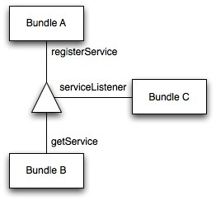
Managing distributed OSGi Runtimes: What is OSGi? (Services)
What is a service?
An Object
A set of properties
The Service Registry
A global registry for all bundles
Registering a service
Getting a service
Listening for services
Notes:
We have a sales and marketing engine that is very similar to
Primarily a telesales based organization. We use the web as a conduit to provide all of the resources needed for customers to investigate and do a POC. The types of offers we provide range from free items like webinars, code examples, documentation, through things that they can pay for like virtual instructor led course, healthcheck, development support subscription and deployment subscription. We make our money on the subscription. What is the pricing model for your subscription? We price by the machine it is like a CPU based pricing. Would a standard be a dual core or quad core. You can buy a subscription for $10K for CPU or $20K for dual core. We also have discount pricing and we have developer pricing which is 8X5 and access to developer and training. We charge by the seat in that model, costs about $5K. Have you compared cost of Fuse versus commercial software. Depends on the number of years you run the model. Year one you are talking about 25-30% of the cost versus a commercially licensed ESB. That is no different than any of the other open source categories that have emerged. Certain industries are cost sensitive like retail and government who are big early adopters of open source – they view IT as a cost center. We are providing pedestrian pricing for pedestrian applications. Are you bottom feeding? No these companies are looking for the best of both worlds. They are looking for software that works at a low price where they can get big company help when they need it. We tend to focus on the cool, strategic, sexy apps as industry insiders, but most of the business is in the middle. These projects are very mature, 1000s of apps built on them. What’s the ballpark of subscription $30-50K taking out the outliers. There are some very big ones, there numbers are huge too. We have 200 customers, subscription customers probably closer to 75. we had 135% topline growth last year. This model works if you have a large, thriving open source community underlying it. In this case we do.

Slide 9
Managing distributed OSGi Runtimes: What makes OSGi really cool?
A slide that could be a presentation on its own
Modularity
Sensible programming model
Let’s focus
Dynamic nature
Updatable bundles
Installing / Uninstalling bundles at runtime (no restarts needed)
Dynamically adding functionality via OSGi services
Why is that so important?
Things are bound to change
Notes:
We have a sales and marketing engine that is very similar to
Primarily a telesales based organization. We use the web as a conduit to provide all of the resources needed for customers to investigate and do a POC. The types of offers we provide range from free items like webinars, code examples, documentation, through things that they can pay for like virtual instructor led course, healthcheck, development support subscription and deployment subscription. We make our money on the subscription. What is the pricing model for your subscription? We price by the machine it is like a CPU based pricing. Would a standard be a dual core or quad core. You can buy a subscription for $10K for CPU or $20K for dual core. We also have discount pricing and we have developer pricing which is 8X5 and access to developer and training. We charge by the seat in that model, costs about $5K. Have you compared cost of Fuse versus commercial software. Depends on the number of years you run the model. Year one you are talking about 25-30% of the cost versus a commercially licensed ESB. That is no different than any of the other open source categories that have emerged. Certain industries are cost sensitive like retail and government who are big early adopters of open source – they view IT as a cost center. We are providing pedestrian pricing for pedestrian applications. Are you bottom feeding? No these companies are looking for the best of both worlds. They are looking for software that works at a low price where they can get big company help when they need it. We tend to focus on the cool, strategic, sexy apps as industry insiders, but most of the business is in the middle. These projects are very mature, 1000s of apps built on them. What’s the ballpark of subscription $30-50K taking out the outliers. There are some very big ones, there numbers are huge too. We have 200 customers, subscription customers probably closer to 75. we had 135% topline growth last year. This model works if you have a large, thriving open source community underlying it. In this case we do.

Slide 10
Managing distributed OSGi Runtimes: What is Karaf’s added coolness?
A set of standard services
Logging Service
Configuration Admin
Features Concept
Easy to use provisioning mechanism
Grouping of bundles & configuration into features
Composing an application from multiple features
Interaction with the OBR
Deployers
Bundle
Features
War
Spring / Blueprint
Notes:
We have a sales and marketing engine that is very similar to
Primarily a telesales based organization. We use the web as a conduit to provide all of the resources needed for customers to investigate and do a POC. The types of offers we provide range from free items like webinars, code examples, documentation, through things that they can pay for like virtual instructor led course, healthcheck, development support subscription and deployment subscription. We make our money on the subscription. What is the pricing model for your subscription? We price by the machine it is like a CPU based pricing. Would a standard be a dual core or quad core. You can buy a subscription for $10K for CPU or $20K for dual core. We also have discount pricing and we have developer pricing which is 8X5 and access to developer and training. We charge by the seat in that model, costs about $5K. Have you compared cost of Fuse versus commercial software. Depends on the number of years you run the model. Year one you are talking about 25-30% of the cost versus a commercially licensed ESB. That is no different than any of the other open source categories that have emerged. Certain industries are cost sensitive like retail and government who are big early adopters of open source – they view IT as a cost center. We are providing pedestrian pricing for pedestrian applications. Are you bottom feeding? No these companies are looking for the best of both worlds. They are looking for software that works at a low price where they can get big company help when they need it. We tend to focus on the cool, strategic, sexy apps as industry insiders, but most of the business is in the middle. These projects are very mature, 1000s of apps built on them. What’s the ballpark of subscription $30-50K taking out the outliers. There are some very big ones, there numbers are huge too. We have 200 customers, subscription customers probably closer to 75. we had 135% topline growth last year. This model works if you have a large, thriving open source community underlying it. In this case we do.

Slide 11
Managing distributed OSGi Runtimes: A new “challenge”
Embracing dynamism is great
Being able to update parts of the application
Being able to modify the runtime behavior of an existing application
Being able to dynamically reconfigure the application
What happens in distributed environments?
How do I reconfigure multiple runtimes?
How do I install a new bundle in multiple runtimes?
How do I install a feature in multiple runtimes?
Can one runtime consume an OSGI service provided by an other?
How can I discover which logical services provided by which runtime?
Notes:
We have a sales and marketing engine that is very similar to
Primarily a telesales based organization. We use the web as a conduit to provide all of the resources needed for customers to investigate and do a POC. The types of offers we provide range from free items like webinars, code examples, documentation, through things that they can pay for like virtual instructor led course, healthcheck, development support subscription and deployment subscription. We make our money on the subscription. What is the pricing model for your subscription? We price by the machine it is like a CPU based pricing. Would a standard be a dual core or quad core. You can buy a subscription for $10K for CPU or $20K for dual core. We also have discount pricing and we have developer pricing which is 8X5 and access to developer and training. We charge by the seat in that model, costs about $5K. Have you compared cost of Fuse versus commercial software. Depends on the number of years you run the model. Year one you are talking about 25-30% of the cost versus a commercially licensed ESB. That is no different than any of the other open source categories that have emerged. Certain industries are cost sensitive like retail and government who are big early adopters of open source – they view IT as a cost center. We are providing pedestrian pricing for pedestrian applications. Are you bottom feeding? No these companies are looking for the best of both worlds. They are looking for software that works at a low price where they can get big company help when they need it. We tend to focus on the cool, strategic, sexy apps as industry insiders, but most of the business is in the middle. These projects are very mature, 1000s of apps built on them. What’s the ballpark of subscription $30-50K taking out the outliers. There are some very big ones, there numbers are huge too. We have 200 customers, subscription customers probably closer to 75. we had 135% topline growth last year. This model works if you have a large, thriving open source community underlying it. In this case we do.

Slide 12
Managing distributed OSGi Runtimes: A new “challenge”
Projects that were designed to help you meet this challenge
Apache Karaf Cellar
Fuse Fabric
Notes:
We have a sales and marketing engine that is very similar to
Primarily a telesales based organization. We use the web as a conduit to provide all of the resources needed for customers to investigate and do a POC. The types of offers we provide range from free items like webinars, code examples, documentation, through things that they can pay for like virtual instructor led course, healthcheck, development support subscription and deployment subscription. We make our money on the subscription. What is the pricing model for your subscription? We price by the machine it is like a CPU based pricing. Would a standard be a dual core or quad core. You can buy a subscription for $10K for CPU or $20K for dual core. We also have discount pricing and we have developer pricing which is 8X5 and access to developer and training. We charge by the seat in that model, costs about $5K. Have you compared cost of Fuse versus commercial software. Depends on the number of years you run the model. Year one you are talking about 25-30% of the cost versus a commercially licensed ESB. That is no different than any of the other open source categories that have emerged. Certain industries are cost sensitive like retail and government who are big early adopters of open source – they view IT as a cost center. We are providing pedestrian pricing for pedestrian applications. Are you bottom feeding? No these companies are looking for the best of both worlds. They are looking for software that works at a low price where they can get big company help when they need it. We tend to focus on the cool, strategic, sexy apps as industry insiders, but most of the business is in the middle. These projects are very mature, 1000s of apps built on them. What’s the ballpark of subscription $30-50K taking out the outliers. There are some very big ones, there numbers are huge too. We have 200 customers, subscription customers probably closer to 75. we had 135% topline growth last year. This model works if you have a large, thriving open source community underlying it. In this case we do.

Slide 13
Agenda
Managing distributed OSGi Runtimes
Apache Karaf Cellar
Fuse Fabric
Questions & Answers
Notes:
We have a sales and marketing engine that is very similar to
Primarily a telesales based organization. We use the web as a conduit to provide all of the resources needed for customers to investigate and do a POC. The types of offers we provide range from free items like webinars, code examples, documentation, through things that they can pay for like virtual instructor led course, healthcheck, development support subscription and deployment subscription. We make our money on the subscription. What is the pricing model for your subscription? We price by the machine it is like a CPU based pricing. Would a standard be a dual core or quad core. You can buy a subscription for $10K for CPU or $20K for dual core. We also have discount pricing and we have developer pricing which is 8X5 and access to developer and training. We charge by the seat in that model, costs about $5K. Have you compared cost of Fuse versus commercial software. Depends on the number of years you run the model. Year one you are talking about 25-30% of the cost versus a commercially licensed ESB. That is no different than any of the other open source categories that have emerged. Certain industries are cost sensitive like retail and government who are big early adopters of open source – they view IT as a cost center. We are providing pedestrian pricing for pedestrian applications. Are you bottom feeding? No these companies are looking for the best of both worlds. They are looking for software that works at a low price where they can get big company help when they need it. We tend to focus on the cool, strategic, sexy apps as industry insiders, but most of the business is in the middle. These projects are very mature, 1000s of apps built on them. What’s the ballpark of subscription $30-50K taking out the outliers. There are some very big ones, there numbers are huge too. We have 200 customers, subscription customers probably closer to 75. we had 135% topline growth last year. This model works if you have a large, thriving open source community underlying it. In this case we do.

Slide 14
Agenda
Managing distributed OSGi Runtimes
Apache Karaf Cellar
Architecture
Groups
Configuration admin integration
Bundle replication
Features integration
Distributed services
Fuse Fabric
Questions & Answers
Notes:
We have a sales and marketing engine that is very similar to
Primarily a telesales based organization. We use the web as a conduit to provide all of the resources needed for customers to investigate and do a POC. The types of offers we provide range from free items like webinars, code examples, documentation, through things that they can pay for like virtual instructor led course, healthcheck, development support subscription and deployment subscription. We make our money on the subscription. What is the pricing model for your subscription? We price by the machine it is like a CPU based pricing. Would a standard be a dual core or quad core. You can buy a subscription for $10K for CPU or $20K for dual core. We also have discount pricing and we have developer pricing which is 8X5 and access to developer and training. We charge by the seat in that model, costs about $5K. Have you compared cost of Fuse versus commercial software. Depends on the number of years you run the model. Year one you are talking about 25-30% of the cost versus a commercially licensed ESB. That is no different than any of the other open source categories that have emerged. Certain industries are cost sensitive like retail and government who are big early adopters of open source – they view IT as a cost center. We are providing pedestrian pricing for pedestrian applications. Are you bottom feeding? No these companies are looking for the best of both worlds. They are looking for software that works at a low price where they can get big company help when they need it. We tend to focus on the cool, strategic, sexy apps as industry insiders, but most of the business is in the middle. These projects are very mature, 1000s of apps built on them. What’s the ballpark of subscription $30-50K taking out the outliers. There are some very big ones, there numbers are huge too. We have 200 customers, subscription customers probably closer to 75. we had 135% topline growth last year. This model works if you have a large, thriving open source community underlying it. In this case we do.

Slide 15
Apache Karaf Cellar Overview
Basic principals
Keep it as simple as possible (K.I.S.S. principal)
Replicate changes changes across multiple runtimes
Mimic the steps that would otherwise be manual
Core features
Uses and manages Hazelcast
Pluggable discovery (multicast, unicast, cloud)
Groups of runtimes
Keeping containers in sync
Configuration replication
Bundle / Feature replication
Distributed OSGi services
Notes:
We have a sales and marketing engine that is very similar to
Primarily a telesales based organization. We use the web as a conduit to provide all of the resources needed for customers to investigate and do a POC. The types of offers we provide range from free items like webinars, code examples, documentation, through things that they can pay for like virtual instructor led course, healthcheck, development support subscription and deployment subscription. We make our money on the subscription. What is the pricing model for your subscription? We price by the machine it is like a CPU based pricing. Would a standard be a dual core or quad core. You can buy a subscription for $10K for CPU or $20K for dual core. We also have discount pricing and we have developer pricing which is 8X5 and access to developer and training. We charge by the seat in that model, costs about $5K. Have you compared cost of Fuse versus commercial software. Depends on the number of years you run the model. Year one you are talking about 25-30% of the cost versus a commercially licensed ESB. That is no different than any of the other open source categories that have emerged. Certain industries are cost sensitive like retail and government who are big early adopters of open source – they view IT as a cost center. We are providing pedestrian pricing for pedestrian applications. Are you bottom feeding? No these companies are looking for the best of both worlds. They are looking for software that works at a low price where they can get big company help when they need it. We tend to focus on the cool, strategic, sexy apps as industry insiders, but most of the business is in the middle. These projects are very mature, 1000s of apps built on them. What’s the ballpark of subscription $30-50K taking out the outliers. There are some very big ones, there numbers are huge too. We have 200 customers, subscription customers probably closer to 75. we had 135% topline growth last year. This model works if you have a large, thriving open source community underlying it. In this case we do.

Slide 16
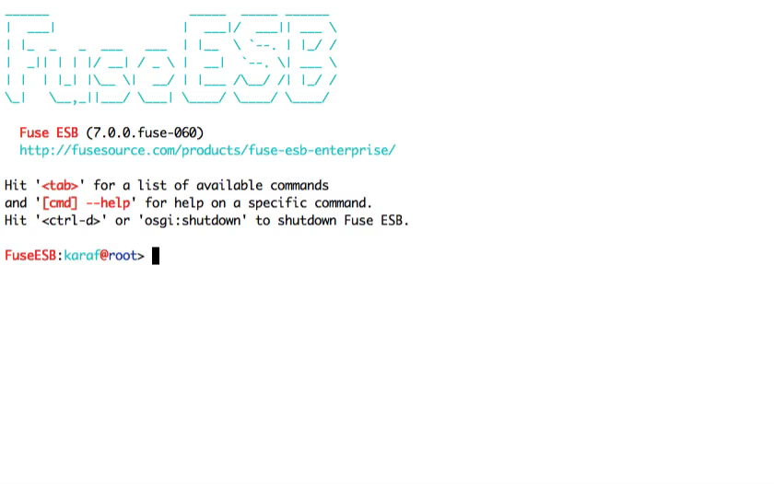
Apache Karaf Cellar Overview: “Installing Cellar”
Notes:
We have a sales and marketing engine that is very similar to
Primarily a telesales based organization. We use the web as a conduit to provide all of the resources needed for customers to investigate and do a POC. The types of offers we provide range from free items like webinars, code examples, documentation, through things that they can pay for like virtual instructor led course, healthcheck, development support subscription and deployment subscription. We make our money on the subscription. What is the pricing model for your subscription? We price by the machine it is like a CPU based pricing. Would a standard be a dual core or quad core. You can buy a subscription for $10K for CPU or $20K for dual core. We also have discount pricing and we have developer pricing which is 8X5 and access to developer and training. We charge by the seat in that model, costs about $5K. Have you compared cost of Fuse versus commercial software. Depends on the number of years you run the model. Year one you are talking about 25-30% of the cost versus a commercially licensed ESB. That is no different than any of the other open source categories that have emerged. Certain industries are cost sensitive like retail and government who are big early adopters of open source – they view IT as a cost center. We are providing pedestrian pricing for pedestrian applications. Are you bottom feeding? No these companies are looking for the best of both worlds. They are looking for software that works at a low price where they can get big company help when they need it. We tend to focus on the cool, strategic, sexy apps as industry insiders, but most of the business is in the middle. These projects are very mature, 1000s of apps built on them. What’s the ballpark of subscription $30-50K taking out the outliers. There are some very big ones, there numbers are huge too. We have 200 customers, subscription customers probably closer to 75. we had 135% topline growth last year. This model works if you have a large, thriving open source community underlying it. In this case we do.

Slide 17
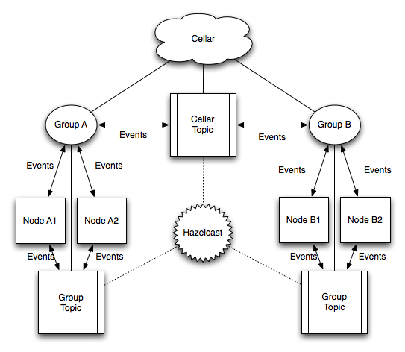
Apache Karaf Cellar Architecture
Notes:
We have a sales and marketing engine that is very similar to
Primarily a telesales based organization. We use the web as a conduit to provide all of the resources needed for customers to investigate and do a POC. The types of offers we provide range from free items like webinars, code examples, documentation, through things that they can pay for like virtual instructor led course, healthcheck, development support subscription and deployment subscription. We make our money on the subscription. What is the pricing model for your subscription? We price by the machine it is like a CPU based pricing. Would a standard be a dual core or quad core. You can buy a subscription for $10K for CPU or $20K for dual core. We also have discount pricing and we have developer pricing which is 8X5 and access to developer and training. We charge by the seat in that model, costs about $5K. Have you compared cost of Fuse versus commercial software. Depends on the number of years you run the model. Year one you are talking about 25-30% of the cost versus a commercially licensed ESB. That is no different than any of the other open source categories that have emerged. Certain industries are cost sensitive like retail and government who are big early adopters of open source – they view IT as a cost center. We are providing pedestrian pricing for pedestrian applications. Are you bottom feeding? No these companies are looking for the best of both worlds. They are looking for software that works at a low price where they can get big company help when they need it. We tend to focus on the cool, strategic, sexy apps as industry insiders, but most of the business is in the middle. These projects are very mature, 1000s of apps built on them. What’s the ballpark of subscription $30-50K taking out the outliers. There are some very big ones, there numbers are huge too. We have 200 customers, subscription customers probably closer to 75. we had 135% topline growth last year. This model works if you have a large, thriving open source community underlying it. In this case we do.

Slide 18
Apache Karaf Cellar Groups
Why do I need groups?
You are not always running a single application.
Not all containers need to host exactly the same layers
Fronted, Backend, integration etc.
How does cellar treat groups?
Nodes can be grouped together
Each group has a dedicated communication transport
Nodes can “sync” state with group buddies
Notes:
We have a sales and marketing engine that is very similar to
Primarily a telesales based organization. We use the web as a conduit to provide all of the resources needed for customers to investigate and do a POC. The types of offers we provide range from free items like webinars, code examples, documentation, through things that they can pay for like virtual instructor led course, healthcheck, development support subscription and deployment subscription. We make our money on the subscription. What is the pricing model for your subscription? We price by the machine it is like a CPU based pricing. Would a standard be a dual core or quad core. You can buy a subscription for $10K for CPU or $20K for dual core. We also have discount pricing and we have developer pricing which is 8X5 and access to developer and training. We charge by the seat in that model, costs about $5K. Have you compared cost of Fuse versus commercial software. Depends on the number of years you run the model. Year one you are talking about 25-30% of the cost versus a commercially licensed ESB. That is no different than any of the other open source categories that have emerged. Certain industries are cost sensitive like retail and government who are big early adopters of open source – they view IT as a cost center. We are providing pedestrian pricing for pedestrian applications. Are you bottom feeding? No these companies are looking for the best of both worlds. They are looking for software that works at a low price where they can get big company help when they need it. We tend to focus on the cool, strategic, sexy apps as industry insiders, but most of the business is in the middle. These projects are very mature, 1000s of apps built on them. What’s the ballpark of subscription $30-50K taking out the outliers. There are some very big ones, there numbers are huge too. We have 200 customers, subscription customers probably closer to 75. we had 135% topline growth last year. This model works if you have a large, thriving open source community underlying it. In this case we do.

Slide 19
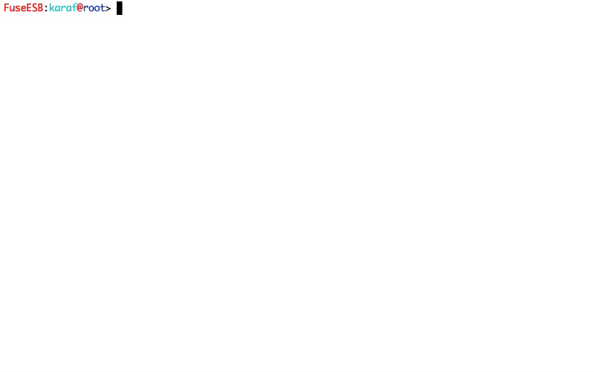
Apache Karaf Cellar Groups
Notes:
We have a sales and marketing engine that is very similar to
Primarily a telesales based organization. We use the web as a conduit to provide all of the resources needed for customers to investigate and do a POC. The types of offers we provide range from free items like webinars, code examples, documentation, through things that they can pay for like virtual instructor led course, healthcheck, development support subscription and deployment subscription. We make our money on the subscription. What is the pricing model for your subscription? We price by the machine it is like a CPU based pricing. Would a standard be a dual core or quad core. You can buy a subscription for $10K for CPU or $20K for dual core. We also have discount pricing and we have developer pricing which is 8X5 and access to developer and training. We charge by the seat in that model, costs about $5K. Have you compared cost of Fuse versus commercial software. Depends on the number of years you run the model. Year one you are talking about 25-30% of the cost versus a commercially licensed ESB. That is no different than any of the other open source categories that have emerged. Certain industries are cost sensitive like retail and government who are big early adopters of open source – they view IT as a cost center. We are providing pedestrian pricing for pedestrian applications. Are you bottom feeding? No these companies are looking for the best of both worlds. They are looking for software that works at a low price where they can get big company help when they need it. We tend to focus on the cool, strategic, sexy apps as industry insiders, but most of the business is in the middle. These projects are very mature, 1000s of apps built on them. What’s the ballpark of subscription $30-50K taking out the outliers. There are some very big ones, there numbers are huge too. We have 200 customers, subscription customers probably closer to 75. we had 135% topline growth last year. This model works if you have a large, thriving open source community underlying it. In this case we do.

Slide 20
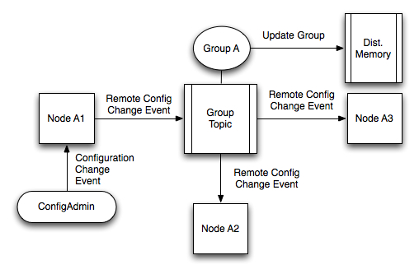
Apache Karaf Cellar Configuration admin integration
Listens for configuration change events
Broadcasts events to nodes of the same group (optional)
Supports event blacklist / white list
Supports group pre configuration (optional)
Notes:
We have a sales and marketing engine that is very similar to
Primarily a telesales based organization. We use the web as a conduit to provide all of the resources needed for customers to investigate and do a POC. The types of offers we provide range from free items like webinars, code examples, documentation, through things that they can pay for like virtual instructor led course, healthcheck, development support subscription and deployment subscription. We make our money on the subscription. What is the pricing model for your subscription? We price by the machine it is like a CPU based pricing. Would a standard be a dual core or quad core. You can buy a subscription for $10K for CPU or $20K for dual core. We also have discount pricing and we have developer pricing which is 8X5 and access to developer and training. We charge by the seat in that model, costs about $5K. Have you compared cost of Fuse versus commercial software. Depends on the number of years you run the model. Year one you are talking about 25-30% of the cost versus a commercially licensed ESB. That is no different than any of the other open source categories that have emerged. Certain industries are cost sensitive like retail and government who are big early adopters of open source – they view IT as a cost center. We are providing pedestrian pricing for pedestrian applications. Are you bottom feeding? No these companies are looking for the best of both worlds. They are looking for software that works at a low price where they can get big company help when they need it. We tend to focus on the cool, strategic, sexy apps as industry insiders, but most of the business is in the middle. These projects are very mature, 1000s of apps built on them. What’s the ballpark of subscription $30-50K taking out the outliers. There are some very big ones, there numbers are huge too. We have 200 customers, subscription customers probably closer to 75. we had 135% topline growth last year. This model works if you have a large, thriving open source community underlying it. In this case we do.

Slide 21
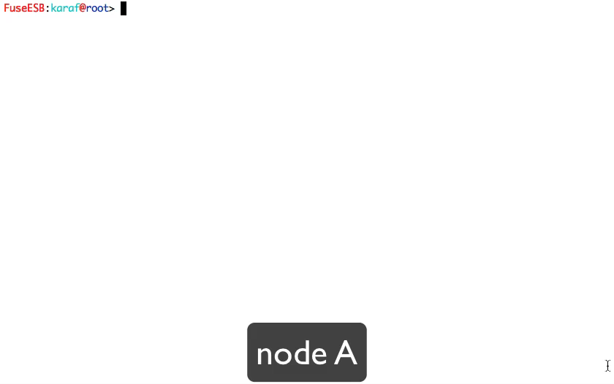
Apache Karaf Cellar Syncing configuration between members
Notes:
We have a sales and marketing engine that is very similar to
Primarily a telesales based organization. We use the web as a conduit to provide all of the resources needed for customers to investigate and do a POC. The types of offers we provide range from free items like webinars, code examples, documentation, through things that they can pay for like virtual instructor led course, healthcheck, development support subscription and deployment subscription. We make our money on the subscription. What is the pricing model for your subscription? We price by the machine it is like a CPU based pricing. Would a standard be a dual core or quad core. You can buy a subscription for $10K for CPU or $20K for dual core. We also have discount pricing and we have developer pricing which is 8X5 and access to developer and training. We charge by the seat in that model, costs about $5K. Have you compared cost of Fuse versus commercial software. Depends on the number of years you run the model. Year one you are talking about 25-30% of the cost versus a commercially licensed ESB. That is no different than any of the other open source categories that have emerged. Certain industries are cost sensitive like retail and government who are big early adopters of open source – they view IT as a cost center. We are providing pedestrian pricing for pedestrian applications. Are you bottom feeding? No these companies are looking for the best of both worlds. They are looking for software that works at a low price where they can get big company help when they need it. We tend to focus on the cool, strategic, sexy apps as industry insiders, but most of the business is in the middle. These projects are very mature, 1000s of apps built on them. What’s the ballpark of subscription $30-50K taking out the outliers. There are some very big ones, there numbers are huge too. We have 200 customers, subscription customers probably closer to 75. we had 135% topline growth last year. This model works if you have a large, thriving open source community underlying it. In this case we do.

Slide 22
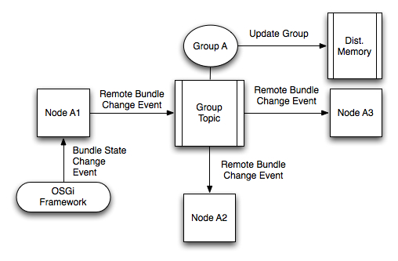
Apache Karaf Cellar Bundle state replication
Listens for bundle events
Broadcasts events to nodes of the same group (optional)
Supports event blacklist / white list
Supports group pre configuration (optional)
Notes:
We have a sales and marketing engine that is very similar to
Primarily a telesales based organization. We use the web as a conduit to provide all of the resources needed for customers to investigate and do a POC. The types of offers we provide range from free items like webinars, code examples, documentation, through things that they can pay for like virtual instructor led course, healthcheck, development support subscription and deployment subscription. We make our money on the subscription. What is the pricing model for your subscription? We price by the machine it is like a CPU based pricing. Would a standard be a dual core or quad core. You can buy a subscription for $10K for CPU or $20K for dual core. We also have discount pricing and we have developer pricing which is 8X5 and access to developer and training. We charge by the seat in that model, costs about $5K. Have you compared cost of Fuse versus commercial software. Depends on the number of years you run the model. Year one you are talking about 25-30% of the cost versus a commercially licensed ESB. That is no different than any of the other open source categories that have emerged. Certain industries are cost sensitive like retail and government who are big early adopters of open source – they view IT as a cost center. We are providing pedestrian pricing for pedestrian applications. Are you bottom feeding? No these companies are looking for the best of both worlds. They are looking for software that works at a low price where they can get big company help when they need it. We tend to focus on the cool, strategic, sexy apps as industry insiders, but most of the business is in the middle. These projects are very mature, 1000s of apps built on them. What’s the ballpark of subscription $30-50K taking out the outliers. There are some very big ones, there numbers are huge too. We have 200 customers, subscription customers probably closer to 75. we had 135% topline growth last year. This model works if you have a large, thriving open source community underlying it. In this case we do.

Slide 23
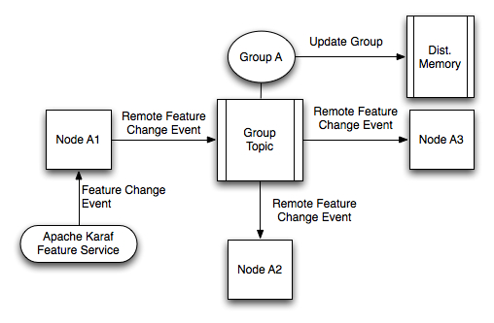
Apache Karaf Cellar Feature Service Integration
Listens for bundle events
Broadcasts events to nodes of the same group (optional)
Supports event blacklist / white list
Supports group pre configuration (optional)
Notes:
We have a sales and marketing engine that is very similar to
Primarily a telesales based organization. We use the web as a conduit to provide all of the resources needed for customers to investigate and do a POC. The types of offers we provide range from free items like webinars, code examples, documentation, through things that they can pay for like virtual instructor led course, healthcheck, development support subscription and deployment subscription. We make our money on the subscription. What is the pricing model for your subscription? We price by the machine it is like a CPU based pricing. Would a standard be a dual core or quad core. You can buy a subscription for $10K for CPU or $20K for dual core. We also have discount pricing and we have developer pricing which is 8X5 and access to developer and training. We charge by the seat in that model, costs about $5K. Have you compared cost of Fuse versus commercial software. Depends on the number of years you run the model. Year one you are talking about 25-30% of the cost versus a commercially licensed ESB. That is no different than any of the other open source categories that have emerged. Certain industries are cost sensitive like retail and government who are big early adopters of open source – they view IT as a cost center. We are providing pedestrian pricing for pedestrian applications. Are you bottom feeding? No these companies are looking for the best of both worlds. They are looking for software that works at a low price where they can get big company help when they need it. We tend to focus on the cool, strategic, sexy apps as industry insiders, but most of the business is in the middle. These projects are very mature, 1000s of apps built on them. What’s the ballpark of subscription $30-50K taking out the outliers. There are some very big ones, there numbers are huge too. We have 200 customers, subscription customers probably closer to 75. we had 135% topline growth last year. This model works if you have a large, thriving open source community underlying it. In this case we do.

Slide 24
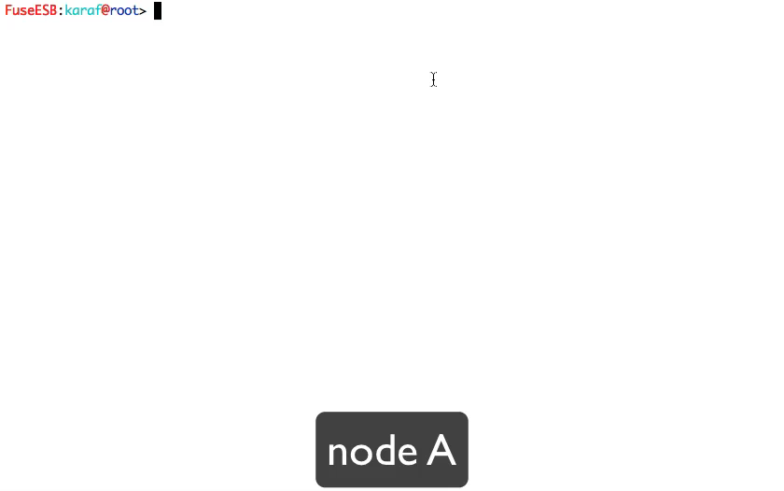
Apache Karaf Cellar Syncing / assigning features to groups
Notes:
We have a sales and marketing engine that is very similar to
Primarily a telesales based organization. We use the web as a conduit to provide all of the resources needed for customers to investigate and do a POC. The types of offers we provide range from free items like webinars, code examples, documentation, through things that they can pay for like virtual instructor led course, healthcheck, development support subscription and deployment subscription. We make our money on the subscription. What is the pricing model for your subscription? We price by the machine it is like a CPU based pricing. Would a standard be a dual core or quad core. You can buy a subscription for $10K for CPU or $20K for dual core. We also have discount pricing and we have developer pricing which is 8X5 and access to developer and training. We charge by the seat in that model, costs about $5K. Have you compared cost of Fuse versus commercial software. Depends on the number of years you run the model. Year one you are talking about 25-30% of the cost versus a commercially licensed ESB. That is no different than any of the other open source categories that have emerged. Certain industries are cost sensitive like retail and government who are big early adopters of open source – they view IT as a cost center. We are providing pedestrian pricing for pedestrian applications. Are you bottom feeding? No these companies are looking for the best of both worlds. They are looking for software that works at a low price where they can get big company help when they need it. We tend to focus on the cool, strategic, sexy apps as industry insiders, but most of the business is in the middle. These projects are very mature, 1000s of apps built on them. What’s the ballpark of subscription $30-50K taking out the outliers. There are some very big ones, there numbers are huge too. We have 200 customers, subscription customers probably closer to 75. we had 135% topline growth last year. This model works if you have a large, thriving open source community underlying it. In this case we do.

Slide 25
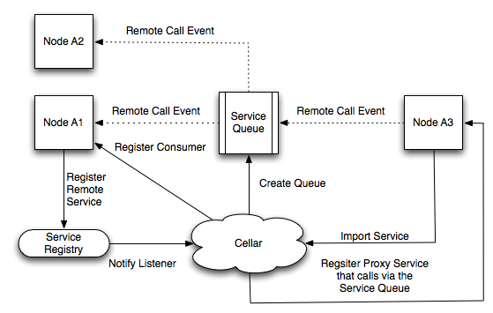
Apache Karaf Cellar Distributed Service Execution
Implementation of OSGi remote service spec. (partial)
Evenly distributed load across nodes
Dynamically scales
Notes:
We have a sales and marketing engine that is very similar to
Primarily a telesales based organization. We use the web as a conduit to provide all of the resources needed for customers to investigate and do a POC. The types of offers we provide range from free items like webinars, code examples, documentation, through things that they can pay for like virtual instructor led course, healthcheck, development support subscription and deployment subscription. We make our money on the subscription. What is the pricing model for your subscription? We price by the machine it is like a CPU based pricing. Would a standard be a dual core or quad core. You can buy a subscription for $10K for CPU or $20K for dual core. We also have discount pricing and we have developer pricing which is 8X5 and access to developer and training. We charge by the seat in that model, costs about $5K. Have you compared cost of Fuse versus commercial software. Depends on the number of years you run the model. Year one you are talking about 25-30% of the cost versus a commercially licensed ESB. That is no different than any of the other open source categories that have emerged. Certain industries are cost sensitive like retail and government who are big early adopters of open source – they view IT as a cost center. We are providing pedestrian pricing for pedestrian applications. Are you bottom feeding? No these companies are looking for the best of both worlds. They are looking for software that works at a low price where they can get big company help when they need it. We tend to focus on the cool, strategic, sexy apps as industry insiders, but most of the business is in the middle. These projects are very mature, 1000s of apps built on them. What’s the ballpark of subscription $30-50K taking out the outliers. There are some very big ones, there numbers are huge too. We have 200 customers, subscription customers probably closer to 75. we had 135% topline growth last year. This model works if you have a large, thriving open source community underlying it. In this case we do.

Slide 26
Apache Karaf Cellar Summarizing
A really simple solution
Configure one container per group and sync the rest
Pluggable discovery mechanism
Helps you scale up
Notes:
We have a sales and marketing engine that is very similar to
Primarily a telesales based organization. We use the web as a conduit to provide all of the resources needed for customers to investigate and do a POC. The types of offers we provide range from free items like webinars, code examples, documentation, through things that they can pay for like virtual instructor led course, healthcheck, development support subscription and deployment subscription. We make our money on the subscription. What is the pricing model for your subscription? We price by the machine it is like a CPU based pricing. Would a standard be a dual core or quad core. You can buy a subscription for $10K for CPU or $20K for dual core. We also have discount pricing and we have developer pricing which is 8X5 and access to developer and training. We charge by the seat in that model, costs about $5K. Have you compared cost of Fuse versus commercial software. Depends on the number of years you run the model. Year one you are talking about 25-30% of the cost versus a commercially licensed ESB. That is no different than any of the other open source categories that have emerged. Certain industries are cost sensitive like retail and government who are big early adopters of open source – they view IT as a cost center. We are providing pedestrian pricing for pedestrian applications. Are you bottom feeding? No these companies are looking for the best of both worlds. They are looking for software that works at a low price where they can get big company help when they need it. We tend to focus on the cool, strategic, sexy apps as industry insiders, but most of the business is in the middle. These projects are very mature, 1000s of apps built on them. What’s the ballpark of subscription $30-50K taking out the outliers. There are some very big ones, there numbers are huge too. We have 200 customers, subscription customers probably closer to 75. we had 135% topline growth last year. This model works if you have a large, thriving open source community underlying it. In this case we do.

Slide 27
Agenda
Managing distributed OSGi Runtimes
Apache Karaf Cellar
Fuse Fabric
Questions & Answers
Notes:
We have a sales and marketing engine that is very similar to
Primarily a telesales based organization. We use the web as a conduit to provide all of the resources needed for customers to investigate and do a POC. The types of offers we provide range from free items like webinars, code examples, documentation, through things that they can pay for like virtual instructor led course, healthcheck, development support subscription and deployment subscription. We make our money on the subscription. What is the pricing model for your subscription? We price by the machine it is like a CPU based pricing. Would a standard be a dual core or quad core. You can buy a subscription for $10K for CPU or $20K for dual core. We also have discount pricing and we have developer pricing which is 8X5 and access to developer and training. We charge by the seat in that model, costs about $5K. Have you compared cost of Fuse versus commercial software. Depends on the number of years you run the model. Year one you are talking about 25-30% of the cost versus a commercially licensed ESB. That is no different than any of the other open source categories that have emerged. Certain industries are cost sensitive like retail and government who are big early adopters of open source – they view IT as a cost center. We are providing pedestrian pricing for pedestrian applications. Are you bottom feeding? No these companies are looking for the best of both worlds. They are looking for software that works at a low price where they can get big company help when they need it. We tend to focus on the cool, strategic, sexy apps as industry insiders, but most of the business is in the middle. These projects are very mature, 1000s of apps built on them. What’s the ballpark of subscription $30-50K taking out the outliers. There are some very big ones, there numbers are huge too. We have 200 customers, subscription customers probably closer to 75. we had 135% topline growth last year. This model works if you have a large, thriving open source community underlying it. In this case we do.

Slide 28
Agenda
Managing distributed OSGi Runtimes
Apache Karaf Cellar
Fuse Fabric
Overview
Architecture
Registry
Fabric Agent
Profiles
Creating remote containers
Middleware integration
Distributed OSGi
Questions & Answers
Notes:
We have a sales and marketing engine that is very similar to
Primarily a telesales based organization. We use the web as a conduit to provide all of the resources needed for customers to investigate and do a POC. The types of offers we provide range from free items like webinars, code examples, documentation, through things that they can pay for like virtual instructor led course, healthcheck, development support subscription and deployment subscription. We make our money on the subscription. What is the pricing model for your subscription? We price by the machine it is like a CPU based pricing. Would a standard be a dual core or quad core. You can buy a subscription for $10K for CPU or $20K for dual core. We also have discount pricing and we have developer pricing which is 8X5 and access to developer and training. We charge by the seat in that model, costs about $5K. Have you compared cost of Fuse versus commercial software. Depends on the number of years you run the model. Year one you are talking about 25-30% of the cost versus a commercially licensed ESB. That is no different than any of the other open source categories that have emerged. Certain industries are cost sensitive like retail and government who are big early adopters of open source – they view IT as a cost center. We are providing pedestrian pricing for pedestrian applications. Are you bottom feeding? No these companies are looking for the best of both worlds. They are looking for software that works at a low price where they can get big company help when they need it. We tend to focus on the cool, strategic, sexy apps as industry insiders, but most of the business is in the middle. These projects are very mature, 1000s of apps built on them. What’s the ballpark of subscription $30-50K taking out the outliers. There are some very big ones, there numbers are huge too. We have 200 customers, subscription customers probably closer to 75. we had 135% topline growth last year. This model works if you have a large, thriving open source community underlying it. In this case we do.

Slide 29
Fuse Fabric: Overview
Open Source System for:
Distributed configuration
Distributed provisioning
Distributed management
Supports Karaf based containers:
Fuse ESB
Fuse MQ
Karaf
Service Mix
Well integrated with:
Camel
ActiveMQ
CXF
Notes:
We have a sales and marketing engine that is very similar to
Primarily a telesales based organization. We use the web as a conduit to provide all of the resources needed for customers to investigate and do a POC. The types of offers we provide range from free items like webinars, code examples, documentation, through things that they can pay for like virtual instructor led course, healthcheck, development support subscription and deployment subscription. We make our money on the subscription. What is the pricing model for your subscription? We price by the machine it is like a CPU based pricing. Would a standard be a dual core or quad core. You can buy a subscription for $10K for CPU or $20K for dual core. We also have discount pricing and we have developer pricing which is 8X5 and access to developer and training. We charge by the seat in that model, costs about $5K. Have you compared cost of Fuse versus commercial software. Depends on the number of years you run the model. Year one you are talking about 25-30% of the cost versus a commercially licensed ESB. That is no different than any of the other open source categories that have emerged. Certain industries are cost sensitive like retail and government who are big early adopters of open source – they view IT as a cost center. We are providing pedestrian pricing for pedestrian applications. Are you bottom feeding? No these companies are looking for the best of both worlds. They are looking for software that works at a low price where they can get big company help when they need it. We tend to focus on the cool, strategic, sexy apps as industry insiders, but most of the business is in the middle. These projects are very mature, 1000s of apps built on them. What’s the ballpark of subscription $30-50K taking out the outliers. There are some very big ones, there numbers are huge too. We have 200 customers, subscription customers probably closer to 75. we had 135% topline growth last year. This model works if you have a large, thriving open source community underlying it. In this case we do.

Slide 30
Fuse Fabric: Overview (cont.)
Core concepts
Fabric registry
Formed by an even number of containers
Holds all configuration data
Registry for distributed services
Profile
Describes the container setup
Features, Bundles, FABs, Configuration PIDs etc
Hierarchical structure
Versioning
Easy means to upgrade / rollback containers
Fabric Agent
Runs on each container
Makes sure that the container “provisions” its assigned profiles.
Notes:
We have a sales and marketing engine that is very similar to
Primarily a telesales based organization. We use the web as a conduit to provide all of the resources needed for customers to investigate and do a POC. The types of offers we provide range from free items like webinars, code examples, documentation, through things that they can pay for like virtual instructor led course, healthcheck, development support subscription and deployment subscription. We make our money on the subscription. What is the pricing model for your subscription? We price by the machine it is like a CPU based pricing. Would a standard be a dual core or quad core. You can buy a subscription for $10K for CPU or $20K for dual core. We also have discount pricing and we have developer pricing which is 8X5 and access to developer and training. We charge by the seat in that model, costs about $5K. Have you compared cost of Fuse versus commercial software. Depends on the number of years you run the model. Year one you are talking about 25-30% of the cost versus a commercially licensed ESB. That is no different than any of the other open source categories that have emerged. Certain industries are cost sensitive like retail and government who are big early adopters of open source – they view IT as a cost center. We are providing pedestrian pricing for pedestrian applications. Are you bottom feeding? No these companies are looking for the best of both worlds. They are looking for software that works at a low price where they can get big company help when they need it. We tend to focus on the cool, strategic, sexy apps as industry insiders, but most of the business is in the middle. These projects are very mature, 1000s of apps built on them. What’s the ballpark of subscription $30-50K taking out the outliers. There are some very big ones, there numbers are huge too. We have 200 customers, subscription customers probably closer to 75. we had 135% topline growth last year. This model works if you have a large, thriving open source community underlying it. In this case we do.

Slide 31
Fuse Fabric: Overview (cont.)
Core features
Provisioning
Deploy apps to containers using profiles
Incremental upgrades / rollbacks for containers
From configuration to the OSGi framework itself
Discovery
ActiveMQ brokers
Camel endpoints
CXF endpoints
Installation of remote containers
Install the runtime itself on remote hosts.
Creation of cloud instances & installation of runtime.
Management
Fuse Management Console (aka FMC)
Fuse IDE
Notes:
We have a sales and marketing engine that is very similar to
Primarily a telesales based organization. We use the web as a conduit to provide all of the resources needed for customers to investigate and do a POC. The types of offers we provide range from free items like webinars, code examples, documentation, through things that they can pay for like virtual instructor led course, healthcheck, development support subscription and deployment subscription. We make our money on the subscription. What is the pricing model for your subscription? We price by the machine it is like a CPU based pricing. Would a standard be a dual core or quad core. You can buy a subscription for $10K for CPU or $20K for dual core. We also have discount pricing and we have developer pricing which is 8X5 and access to developer and training. We charge by the seat in that model, costs about $5K. Have you compared cost of Fuse versus commercial software. Depends on the number of years you run the model. Year one you are talking about 25-30% of the cost versus a commercially licensed ESB. That is no different than any of the other open source categories that have emerged. Certain industries are cost sensitive like retail and government who are big early adopters of open source – they view IT as a cost center. We are providing pedestrian pricing for pedestrian applications. Are you bottom feeding? No these companies are looking for the best of both worlds. They are looking for software that works at a low price where they can get big company help when they need it. We tend to focus on the cool, strategic, sexy apps as industry insiders, but most of the business is in the middle. These projects are very mature, 1000s of apps built on them. What’s the ballpark of subscription $30-50K taking out the outliers. There are some very big ones, there numbers are huge too. We have 200 customers, subscription customers probably closer to 75. we had 135% topline growth last year. This model works if you have a large, thriving open source community underlying it. In this case we do.

Slide 32

Fuse Fabric: Architecture
containers that form an “ensemble”
Agent
Agent
Agent
Clustered Registry
Zookeeper
Zookeeper
Zookeeper
Registry Content
Version 1.0
Registers / Listens for changes
Profile Default
Agent
Profile Camel
Profile CXF
Pulls profile data
Features
Configuration
Notes:
We have a sales and marketing engine that is very similar to
Primarily a telesales based organization. We use the web as a conduit to provide all of the resources needed for customers to investigate and do a POC. The types of offers we provide range from free items like webinars, code examples, documentation, through things that they can pay for like virtual instructor led course, healthcheck, development support subscription and deployment subscription. We make our money on the subscription. What is the pricing model for your subscription? We price by the machine it is like a CPU based pricing. Would a standard be a dual core or quad core. You can buy a subscription for $10K for CPU or $20K for dual core. We also have discount pricing and we have developer pricing which is 8X5 and access to developer and training. We charge by the seat in that model, costs about $5K. Have you compared cost of Fuse versus commercial software. Depends on the number of years you run the model. Year one you are talking about 25-30% of the cost versus a commercially licensed ESB. That is no different than any of the other open source categories that have emerged. Certain industries are cost sensitive like retail and government who are big early adopters of open source – they view IT as a cost center. We are providing pedestrian pricing for pedestrian applications. Are you bottom feeding? No these companies are looking for the best of both worlds. They are looking for software that works at a low price where they can get big company help when they need it. We tend to focus on the cool, strategic, sexy apps as industry insiders, but most of the business is in the middle. These projects are very mature, 1000s of apps built on them. What’s the ballpark of subscription $30-50K taking out the outliers. There are some very big ones, there numbers are huge too. We have 200 customers, subscription customers probably closer to 75. we had 135% topline growth last year. This model works if you have a large, thriving open source community underlying it. In this case we do.

Slide 33
Fuse Fabric: Registry
Based on Apache Zookeeper
A highly available service that provides
Configuration information services
Distrusted synchronization etc
Registry Model
Hierarchy of “znode” similar to a file system
Each “znode” can hold data and/or have children.
Setup Options
Create a zookeeper ensemble from fabric (fabric managed)
Create, add or remove containers from the ensemble
Use an existing zookeeper ensemble to host the registry
Management
Shell commands to interact with the registry at zookeeper level
Tools to import & export registry content to files
Notes:
We have a sales and marketing engine that is very similar to
Primarily a telesales based organization. We use the web as a conduit to provide all of the resources needed for customers to investigate and do a POC. The types of offers we provide range from free items like webinars, code examples, documentation, through things that they can pay for like virtual instructor led course, healthcheck, development support subscription and deployment subscription. We make our money on the subscription. What is the pricing model for your subscription? We price by the machine it is like a CPU based pricing. Would a standard be a dual core or quad core. You can buy a subscription for $10K for CPU or $20K for dual core. We also have discount pricing and we have developer pricing which is 8X5 and access to developer and training. We charge by the seat in that model, costs about $5K. Have you compared cost of Fuse versus commercial software. Depends on the number of years you run the model. Year one you are talking about 25-30% of the cost versus a commercially licensed ESB. That is no different than any of the other open source categories that have emerged. Certain industries are cost sensitive like retail and government who are big early adopters of open source – they view IT as a cost center. We are providing pedestrian pricing for pedestrian applications. Are you bottom feeding? No these companies are looking for the best of both worlds. They are looking for software that works at a low price where they can get big company help when they need it. We tend to focus on the cool, strategic, sexy apps as industry insiders, but most of the business is in the middle. These projects are very mature, 1000s of apps built on them. What’s the ballpark of subscription $30-50K taking out the outliers. There are some very big ones, there numbers are huge too. We have 200 customers, subscription customers probably closer to 75. we had 135% topline growth last year. This model works if you have a large, thriving open source community underlying it. In this case we do.

Slide 34

Fuse Fabric: Registry: “Create a new registry”
Notes:
We have a sales and marketing engine that is very similar to
Primarily a telesales based organization. We use the web as a conduit to provide all of the resources needed for customers to investigate and do a POC. The types of offers we provide range from free items like webinars, code examples, documentation, through things that they can pay for like virtual instructor led course, healthcheck, development support subscription and deployment subscription. We make our money on the subscription. What is the pricing model for your subscription? We price by the machine it is like a CPU based pricing. Would a standard be a dual core or quad core. You can buy a subscription for $10K for CPU or $20K for dual core. We also have discount pricing and we have developer pricing which is 8X5 and access to developer and training. We charge by the seat in that model, costs about $5K. Have you compared cost of Fuse versus commercial software. Depends on the number of years you run the model. Year one you are talking about 25-30% of the cost versus a commercially licensed ESB. That is no different than any of the other open source categories that have emerged. Certain industries are cost sensitive like retail and government who are big early adopters of open source – they view IT as a cost center. We are providing pedestrian pricing for pedestrian applications. Are you bottom feeding? No these companies are looking for the best of both worlds. They are looking for software that works at a low price where they can get big company help when they need it. We tend to focus on the cool, strategic, sexy apps as industry insiders, but most of the business is in the middle. These projects are very mature, 1000s of apps built on them. What’s the ballpark of subscription $30-50K taking out the outliers. There are some very big ones, there numbers are huge too. We have 200 customers, subscription customers probably closer to 75. we had 135% topline growth last year. This model works if you have a large, thriving open source community underlying it. In this case we do.

Slide 35

Fuse Fabric: Registry: “Join an existing registry”
Notes:
We have a sales and marketing engine that is very similar to
Primarily a telesales based organization. We use the web as a conduit to provide all of the resources needed for customers to investigate and do a POC. The types of offers we provide range from free items like webinars, code examples, documentation, through things that they can pay for like virtual instructor led course, healthcheck, development support subscription and deployment subscription. We make our money on the subscription. What is the pricing model for your subscription? We price by the machine it is like a CPU based pricing. Would a standard be a dual core or quad core. You can buy a subscription for $10K for CPU or $20K for dual core. We also have discount pricing and we have developer pricing which is 8X5 and access to developer and training. We charge by the seat in that model, costs about $5K. Have you compared cost of Fuse versus commercial software. Depends on the number of years you run the model. Year one you are talking about 25-30% of the cost versus a commercially licensed ESB. That is no different than any of the other open source categories that have emerged. Certain industries are cost sensitive like retail and government who are big early adopters of open source – they view IT as a cost center. We are providing pedestrian pricing for pedestrian applications. Are you bottom feeding? No these companies are looking for the best of both worlds. They are looking for software that works at a low price where they can get big company help when they need it. We tend to focus on the cool, strategic, sexy apps as industry insiders, but most of the business is in the middle. These projects are very mature, 1000s of apps built on them. What’s the ballpark of subscription $30-50K taking out the outliers. There are some very big ones, there numbers are huge too. We have 200 customers, subscription customers probably closer to 75. we had 135% topline growth last year. This model works if you have a large, thriving open source community underlying it. In this case we do.

Slide 36
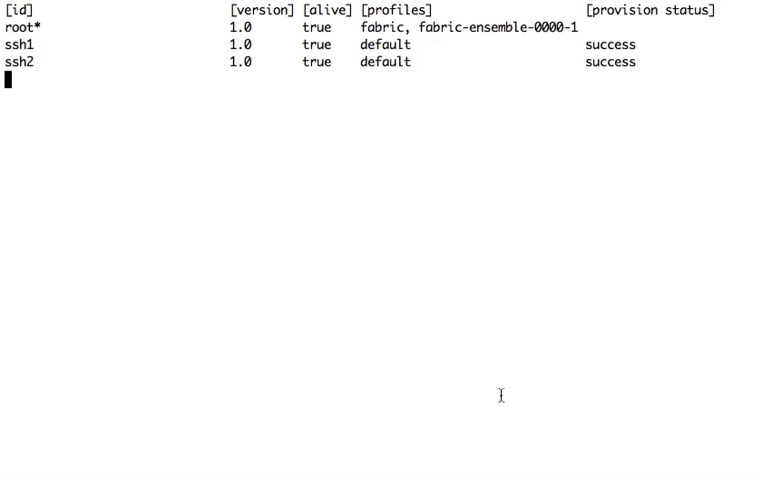
Fuse Fabric: Registry: “Managing the ensemble”
Notes:
We have a sales and marketing engine that is very similar to
Primarily a telesales based organization. We use the web as a conduit to provide all of the resources needed for customers to investigate and do a POC. The types of offers we provide range from free items like webinars, code examples, documentation, through things that they can pay for like virtual instructor led course, healthcheck, development support subscription and deployment subscription. We make our money on the subscription. What is the pricing model for your subscription? We price by the machine it is like a CPU based pricing. Would a standard be a dual core or quad core. You can buy a subscription for $10K for CPU or $20K for dual core. We also have discount pricing and we have developer pricing which is 8X5 and access to developer and training. We charge by the seat in that model, costs about $5K. Have you compared cost of Fuse versus commercial software. Depends on the number of years you run the model. Year one you are talking about 25-30% of the cost versus a commercially licensed ESB. That is no different than any of the other open source categories that have emerged. Certain industries are cost sensitive like retail and government who are big early adopters of open source – they view IT as a cost center. We are providing pedestrian pricing for pedestrian applications. Are you bottom feeding? No these companies are looking for the best of both worlds. They are looking for software that works at a low price where they can get big company help when they need it. We tend to focus on the cool, strategic, sexy apps as industry insiders, but most of the business is in the middle. These projects are very mature, 1000s of apps built on them. What’s the ballpark of subscription $30-50K taking out the outliers. There are some very big ones, there numbers are huge too. We have 200 customers, subscription customers probably closer to 75. we had 135% topline growth last year. This model works if you have a large, thriving open source community underlying it. In this case we do.

Slide 37
Fuse Fabric: Profiles
A description of how a container should be provisioned
Framework
System properties
OSGi configuration
Features, bundles, FABs
Structure & usage
Hierarchical (supports multiple parents)
One or more profiles can be assigned to a container
Can be used to define logical groups of containers
Defaults Profiles
default, karaf
camel, cxf, mq, esb
Notes:
We have a sales and marketing engine that is very similar to
Primarily a telesales based organization. We use the web as a conduit to provide all of the resources needed for customers to investigate and do a POC. The types of offers we provide range from free items like webinars, code examples, documentation, through things that they can pay for like virtual instructor led course, healthcheck, development support subscription and deployment subscription. We make our money on the subscription. What is the pricing model for your subscription? We price by the machine it is like a CPU based pricing. Would a standard be a dual core or quad core. You can buy a subscription for $10K for CPU or $20K for dual core. We also have discount pricing and we have developer pricing which is 8X5 and access to developer and training. We charge by the seat in that model, costs about $5K. Have you compared cost of Fuse versus commercial software. Depends on the number of years you run the model. Year one you are talking about 25-30% of the cost versus a commercially licensed ESB. That is no different than any of the other open source categories that have emerged. Certain industries are cost sensitive like retail and government who are big early adopters of open source – they view IT as a cost center. We are providing pedestrian pricing for pedestrian applications. Are you bottom feeding? No these companies are looking for the best of both worlds. They are looking for software that works at a low price where they can get big company help when they need it. We tend to focus on the cool, strategic, sexy apps as industry insiders, but most of the business is in the middle. These projects are very mature, 1000s of apps built on them. What’s the ballpark of subscription $30-50K taking out the outliers. There are some very big ones, there numbers are huge too. We have 200 customers, subscription customers probably closer to 75. we had 135% topline growth last year. This model works if you have a large, thriving open source community underlying it. In this case we do.

Slide 38
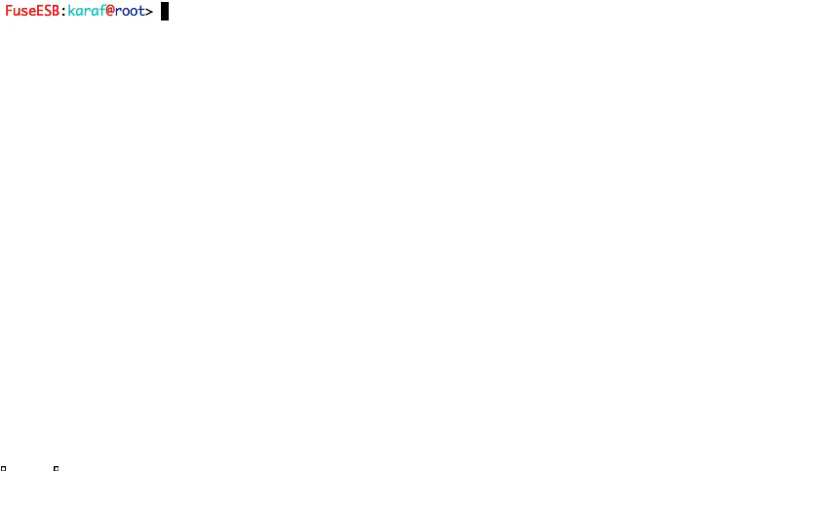
Fuse Fabric: Profiles
Notes:
We have a sales and marketing engine that is very similar to
Primarily a telesales based organization. We use the web as a conduit to provide all of the resources needed for customers to investigate and do a POC. The types of offers we provide range from free items like webinars, code examples, documentation, through things that they can pay for like virtual instructor led course, healthcheck, development support subscription and deployment subscription. We make our money on the subscription. What is the pricing model for your subscription? We price by the machine it is like a CPU based pricing. Would a standard be a dual core or quad core. You can buy a subscription for $10K for CPU or $20K for dual core. We also have discount pricing and we have developer pricing which is 8X5 and access to developer and training. We charge by the seat in that model, costs about $5K. Have you compared cost of Fuse versus commercial software. Depends on the number of years you run the model. Year one you are talking about 25-30% of the cost versus a commercially licensed ESB. That is no different than any of the other open source categories that have emerged. Certain industries are cost sensitive like retail and government who are big early adopters of open source – they view IT as a cost center. We are providing pedestrian pricing for pedestrian applications. Are you bottom feeding? No these companies are looking for the best of both worlds. They are looking for software that works at a low price where they can get big company help when they need it. We tend to focus on the cool, strategic, sexy apps as industry insiders, but most of the business is in the middle. These projects are very mature, 1000s of apps built on them. What’s the ballpark of subscription $30-50K taking out the outliers. There are some very big ones, there numbers are huge too. We have 200 customers, subscription customers probably closer to 75. we had 135% topline growth last year. This model works if you have a large, thriving open source community underlying it. In this case we do.

Slide 39
Fuse Fabric: Agent
Runs on each container that is part of Fabric
Connects to the fabric registry
Reads profiles assigned to the container
Applies configuration, installs bundles, features etc
Listens for changes
Upgrades and rollbacks
Can incrementally update / rollback containers in the cluster
Can update even itself and go as low as the OSGi framework
Where does it get the “artifacts” from?
From a predefined set of public maven repositories
Fabric containers can as maven proxies themselves
Support uploading artifacts in an mvn:deploy manner
Support downloading artifacts
Notes:
We have a sales and marketing engine that is very similar to
Primarily a telesales based organization. We use the web as a conduit to provide all of the resources needed for customers to investigate and do a POC. The types of offers we provide range from free items like webinars, code examples, documentation, through things that they can pay for like virtual instructor led course, healthcheck, development support subscription and deployment subscription. We make our money on the subscription. What is the pricing model for your subscription? We price by the machine it is like a CPU based pricing. Would a standard be a dual core or quad core. You can buy a subscription for $10K for CPU or $20K for dual core. We also have discount pricing and we have developer pricing which is 8X5 and access to developer and training. We charge by the seat in that model, costs about $5K. Have you compared cost of Fuse versus commercial software. Depends on the number of years you run the model. Year one you are talking about 25-30% of the cost versus a commercially licensed ESB. That is no different than any of the other open source categories that have emerged. Certain industries are cost sensitive like retail and government who are big early adopters of open source – they view IT as a cost center. We are providing pedestrian pricing for pedestrian applications. Are you bottom feeding? No these companies are looking for the best of both worlds. They are looking for software that works at a low price where they can get big company help when they need it. We tend to focus on the cool, strategic, sexy apps as industry insiders, but most of the business is in the middle. These projects are very mature, 1000s of apps built on them. What’s the ballpark of subscription $30-50K taking out the outliers. There are some very big ones, there numbers are huge too. We have 200 customers, subscription customers probably closer to 75. we had 135% topline growth last year. This model works if you have a large, thriving open source community underlying it. In this case we do.

Slide 40
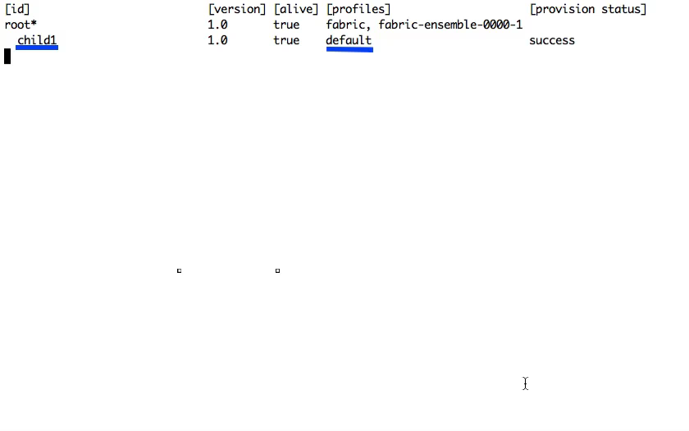
Fuse Fabric: Agent: “Changing the profile”
Notes:
We have a sales and marketing engine that is very similar to
Primarily a telesales based organization. We use the web as a conduit to provide all of the resources needed for customers to investigate and do a POC. The types of offers we provide range from free items like webinars, code examples, documentation, through things that they can pay for like virtual instructor led course, healthcheck, development support subscription and deployment subscription. We make our money on the subscription. What is the pricing model for your subscription? We price by the machine it is like a CPU based pricing. Would a standard be a dual core or quad core. You can buy a subscription for $10K for CPU or $20K for dual core. We also have discount pricing and we have developer pricing which is 8X5 and access to developer and training. We charge by the seat in that model, costs about $5K. Have you compared cost of Fuse versus commercial software. Depends on the number of years you run the model. Year one you are talking about 25-30% of the cost versus a commercially licensed ESB. That is no different than any of the other open source categories that have emerged. Certain industries are cost sensitive like retail and government who are big early adopters of open source – they view IT as a cost center. We are providing pedestrian pricing for pedestrian applications. Are you bottom feeding? No these companies are looking for the best of both worlds. They are looking for software that works at a low price where they can get big company help when they need it. We tend to focus on the cool, strategic, sexy apps as industry insiders, but most of the business is in the middle. These projects are very mature, 1000s of apps built on them. What’s the ballpark of subscription $30-50K taking out the outliers. There are some very big ones, there numbers are huge too. We have 200 customers, subscription customers probably closer to 75. we had 135% topline growth last year. This model works if you have a large, thriving open source community underlying it. In this case we do.

Slide 41
Fuse Fabric: Middleware integration
MQ integration
Containers using the “mq” profiles will automatically start a broker
The broker will register itself in fabric
Fabric containers can discover brokers via fabric
Master / slave support
Camel integration
Any provider endpoint can be registered in fabric
Example: from(“fabric:myendpoint:http://0.0.0.0:8383”)
Discovery & load balancing
Example: from(“direct:start”).to(“fabric:myendpoint”)
CXF integration
Similar to camel
Notes:
We have a sales and marketing engine that is very similar to
Primarily a telesales based organization. We use the web as a conduit to provide all of the resources needed for customers to investigate and do a POC. The types of offers we provide range from free items like webinars, code examples, documentation, through things that they can pay for like virtual instructor led course, healthcheck, development support subscription and deployment subscription. We make our money on the subscription. What is the pricing model for your subscription? We price by the machine it is like a CPU based pricing. Would a standard be a dual core or quad core. You can buy a subscription for $10K for CPU or $20K for dual core. We also have discount pricing and we have developer pricing which is 8X5 and access to developer and training. We charge by the seat in that model, costs about $5K. Have you compared cost of Fuse versus commercial software. Depends on the number of years you run the model. Year one you are talking about 25-30% of the cost versus a commercially licensed ESB. That is no different than any of the other open source categories that have emerged. Certain industries are cost sensitive like retail and government who are big early adopters of open source – they view IT as a cost center. We are providing pedestrian pricing for pedestrian applications. Are you bottom feeding? No these companies are looking for the best of both worlds. They are looking for software that works at a low price where they can get big company help when they need it. We tend to focus on the cool, strategic, sexy apps as industry insiders, but most of the business is in the middle. These projects are very mature, 1000s of apps built on them. What’s the ballpark of subscription $30-50K taking out the outliers. There are some very big ones, there numbers are huge too. We have 200 customers, subscription customers probably closer to 75. we had 135% topline growth last year. This model works if you have a large, thriving open source community underlying it. In this case we do.

Slide 42
Fuse Fabric: Distributed OSGi services
Distributed OSGi services implementation
As simple as adding a property to a service
service.exported.interfaces
Uses insanely fast hawtdispatch
Can be used consumed from non-OSGi clients
Examples:
Fabric ships a dosgi profile you can use “out of the box”
Fabric examples contain a camel & dosgi example
Notes:
We have a sales and marketing engine that is very similar to
Primarily a telesales based organization. We use the web as a conduit to provide all of the resources needed for customers to investigate and do a POC. The types of offers we provide range from free items like webinars, code examples, documentation, through things that they can pay for like virtual instructor led course, healthcheck, development support subscription and deployment subscription. We make our money on the subscription. What is the pricing model for your subscription? We price by the machine it is like a CPU based pricing. Would a standard be a dual core or quad core. You can buy a subscription for $10K for CPU or $20K for dual core. We also have discount pricing and we have developer pricing which is 8X5 and access to developer and training. We charge by the seat in that model, costs about $5K. Have you compared cost of Fuse versus commercial software. Depends on the number of years you run the model. Year one you are talking about 25-30% of the cost versus a commercially licensed ESB. That is no different than any of the other open source categories that have emerged. Certain industries are cost sensitive like retail and government who are big early adopters of open source – they view IT as a cost center. We are providing pedestrian pricing for pedestrian applications. Are you bottom feeding? No these companies are looking for the best of both worlds. They are looking for software that works at a low price where they can get big company help when they need it. We tend to focus on the cool, strategic, sexy apps as industry insiders, but most of the business is in the middle. These projects are very mature, 1000s of apps built on them. What’s the ballpark of subscription $30-50K taking out the outliers. There are some very big ones, there numbers are huge too. We have 200 customers, subscription customers probably closer to 75. we had 135% topline growth last year. This model works if you have a large, thriving open source community underlying it. In this case we do.

Slide 43
Fuse Fabric: Creating remote containers
“Fabric can weave itself”
Can create “new’ containers with any profile from scratch
Locally in a separate jvm
On remote ssh enabled hosts
In the cloud
Public Cloud (EC2, Rackspace etc)
Private Cloud
Hybrid Cloud
Notes:
We have a sales and marketing engine that is very similar to
Primarily a telesales based organization. We use the web as a conduit to provide all of the resources needed for customers to investigate and do a POC. The types of offers we provide range from free items like webinars, code examples, documentation, through things that they can pay for like virtual instructor led course, healthcheck, development support subscription and deployment subscription. We make our money on the subscription. What is the pricing model for your subscription? We price by the machine it is like a CPU based pricing. Would a standard be a dual core or quad core. You can buy a subscription for $10K for CPU or $20K for dual core. We also have discount pricing and we have developer pricing which is 8X5 and access to developer and training. We charge by the seat in that model, costs about $5K. Have you compared cost of Fuse versus commercial software. Depends on the number of years you run the model. Year one you are talking about 25-30% of the cost versus a commercially licensed ESB. That is no different than any of the other open source categories that have emerged. Certain industries are cost sensitive like retail and government who are big early adopters of open source – they view IT as a cost center. We are providing pedestrian pricing for pedestrian applications. Are you bottom feeding? No these companies are looking for the best of both worlds. They are looking for software that works at a low price where they can get big company help when they need it. We tend to focus on the cool, strategic, sexy apps as industry insiders, but most of the business is in the middle. These projects are very mature, 1000s of apps built on them. What’s the ballpark of subscription $30-50K taking out the outliers. There are some very big ones, there numbers are huge too. We have 200 customers, subscription customers probably closer to 75. we had 135% topline growth last year. This model works if you have a large, thriving open source community underlying it. In this case we do.

Slide 44
Fuse Fabric: Creating remote containers: “In the local network”
Can make use of your existing servers
Installs fabric via ssh
Support public key authentication
Supports passphrase on key
Starts the runtime
Automatically joins the cluster
Can be assigned any profile
Example use cases & benefits
Add a new message broker in your network in no time
Scale your application by dynamically adding runtimes
Reduce the maintenance overhead
Notes:
We have a sales and marketing engine that is very similar to
Primarily a telesales based organization. We use the web as a conduit to provide all of the resources needed for customers to investigate and do a POC. The types of offers we provide range from free items like webinars, code examples, documentation, through things that they can pay for like virtual instructor led course, healthcheck, development support subscription and deployment subscription. We make our money on the subscription. What is the pricing model for your subscription? We price by the machine it is like a CPU based pricing. Would a standard be a dual core or quad core. You can buy a subscription for $10K for CPU or $20K for dual core. We also have discount pricing and we have developer pricing which is 8X5 and access to developer and training. We charge by the seat in that model, costs about $5K. Have you compared cost of Fuse versus commercial software. Depends on the number of years you run the model. Year one you are talking about 25-30% of the cost versus a commercially licensed ESB. That is no different than any of the other open source categories that have emerged. Certain industries are cost sensitive like retail and government who are big early adopters of open source – they view IT as a cost center. We are providing pedestrian pricing for pedestrian applications. Are you bottom feeding? No these companies are looking for the best of both worlds. They are looking for software that works at a low price where they can get big company help when they need it. We tend to focus on the cool, strategic, sexy apps as industry insiders, but most of the business is in the middle. These projects are very mature, 1000s of apps built on them. What’s the ballpark of subscription $30-50K taking out the outliers. There are some very big ones, there numbers are huge too. We have 200 customers, subscription customers probably closer to 75. we had 135% topline growth last year. This model works if you have a large, thriving open source community underlying it. In this case we do.

Slide 45
Fuse Fabric: Creating remote containers: “In the cloud”
Works with most public cloud providers
Supports private clouds
How fabric makes cloud easy for you
Creates cloud instances
Performs the minimal required firewall management (for hybrids)
Installs all required software (java, curl etc)
Install & starts fabric
Automatically joins the cluster
Notes:
We have a sales and marketing engine that is very similar to
Primarily a telesales based organization. We use the web as a conduit to provide all of the resources needed for customers to investigate and do a POC. The types of offers we provide range from free items like webinars, code examples, documentation, through things that they can pay for like virtual instructor led course, healthcheck, development support subscription and deployment subscription. We make our money on the subscription. What is the pricing model for your subscription? We price by the machine it is like a CPU based pricing. Would a standard be a dual core or quad core. You can buy a subscription for $10K for CPU or $20K for dual core. We also have discount pricing and we have developer pricing which is 8X5 and access to developer and training. We charge by the seat in that model, costs about $5K. Have you compared cost of Fuse versus commercial software. Depends on the number of years you run the model. Year one you are talking about 25-30% of the cost versus a commercially licensed ESB. That is no different than any of the other open source categories that have emerged. Certain industries are cost sensitive like retail and government who are big early adopters of open source – they view IT as a cost center. We are providing pedestrian pricing for pedestrian applications. Are you bottom feeding? No these companies are looking for the best of both worlds. They are looking for software that works at a low price where they can get big company help when they need it. We tend to focus on the cool, strategic, sexy apps as industry insiders, but most of the business is in the middle. These projects are very mature, 1000s of apps built on them. What’s the ballpark of subscription $30-50K taking out the outliers. There are some very big ones, there numbers are huge too. We have 200 customers, subscription customers probably closer to 75. we had 135% topline growth last year. This model works if you have a large, thriving open source community underlying it. In this case we do.

Slide 46
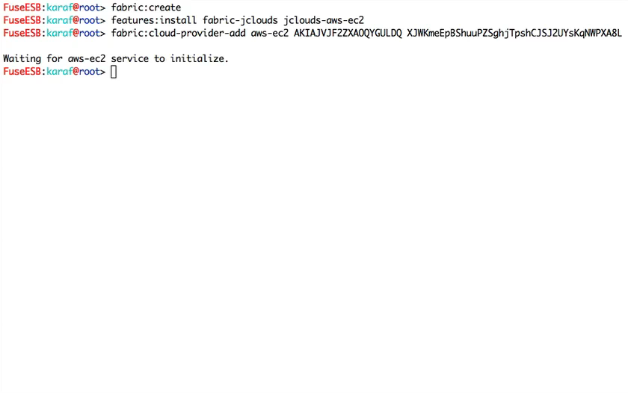
Fuse Fabric: Creating remote containers: In the cloud
Notes:
We have a sales and marketing engine that is very similar to
Primarily a telesales based organization. We use the web as a conduit to provide all of the resources needed for customers to investigate and do a POC. The types of offers we provide range from free items like webinars, code examples, documentation, through things that they can pay for like virtual instructor led course, healthcheck, development support subscription and deployment subscription. We make our money on the subscription. What is the pricing model for your subscription? We price by the machine it is like a CPU based pricing. Would a standard be a dual core or quad core. You can buy a subscription for $10K for CPU or $20K for dual core. We also have discount pricing and we have developer pricing which is 8X5 and access to developer and training. We charge by the seat in that model, costs about $5K. Have you compared cost of Fuse versus commercial software. Depends on the number of years you run the model. Year one you are talking about 25-30% of the cost versus a commercially licensed ESB. That is no different than any of the other open source categories that have emerged. Certain industries are cost sensitive like retail and government who are big early adopters of open source – they view IT as a cost center. We are providing pedestrian pricing for pedestrian applications. Are you bottom feeding? No these companies are looking for the best of both worlds. They are looking for software that works at a low price where they can get big company help when they need it. We tend to focus on the cool, strategic, sexy apps as industry insiders, but most of the business is in the middle. These projects are very mature, 1000s of apps built on them. What’s the ballpark of subscription $30-50K taking out the outliers. There are some very big ones, there numbers are huge too. We have 200 customers, subscription customers probably closer to 75. we had 135% topline growth last year. This model works if you have a large, thriving open source community underlying it. In this case we do.

Slide 47
Fuse Fabric: Summarizing
Central management of how the cluster should be provisioned
Define your profiles & let provisioning to fabric
Not just configuration and deployment
Broader scope that go as low as the runtime itself
Clean way to manage your upgrades & rollbacks
Scaling
Distributed OSGi services
Native support for your “favorite” middleware
Cloud support
Can make use of your “own nodes”
Makes installing container & app to cloud “a piece of cake”
Public clouds
Private clouds
Hybrid couds
Notes:
We have a sales and marketing engine that is very similar to
Primarily a telesales based organization. We use the web as a conduit to provide all of the resources needed for customers to investigate and do a POC. The types of offers we provide range from free items like webinars, code examples, documentation, through things that they can pay for like virtual instructor led course, healthcheck, development support subscription and deployment subscription. We make our money on the subscription. What is the pricing model for your subscription? We price by the machine it is like a CPU based pricing. Would a standard be a dual core or quad core. You can buy a subscription for $10K for CPU or $20K for dual core. We also have discount pricing and we have developer pricing which is 8X5 and access to developer and training. We charge by the seat in that model, costs about $5K. Have you compared cost of Fuse versus commercial software. Depends on the number of years you run the model. Year one you are talking about 25-30% of the cost versus a commercially licensed ESB. That is no different than any of the other open source categories that have emerged. Certain industries are cost sensitive like retail and government who are big early adopters of open source – they view IT as a cost center. We are providing pedestrian pricing for pedestrian applications. Are you bottom feeding? No these companies are looking for the best of both worlds. They are looking for software that works at a low price where they can get big company help when they need it. We tend to focus on the cool, strategic, sexy apps as industry insiders, but most of the business is in the middle. These projects are very mature, 1000s of apps built on them. What’s the ballpark of subscription $30-50K taking out the outliers. There are some very big ones, there numbers are huge too. We have 200 customers, subscription customers probably closer to 75. we had 135% topline growth last year. This model works if you have a large, thriving open source community underlying it. In this case we do.

Slide 48
Agenda
Managing distributed OSGi Runtimes
Apache Karaf Cellar
Fuse Fabric
Questions & Answers
Notes:
We have a sales and marketing engine that is very similar to
Primarily a telesales based organization. We use the web as a conduit to provide all of the resources needed for customers to investigate and do a POC. The types of offers we provide range from free items like webinars, code examples, documentation, through things that they can pay for like virtual instructor led course, healthcheck, development support subscription and deployment subscription. We make our money on the subscription. What is the pricing model for your subscription? We price by the machine it is like a CPU based pricing. Would a standard be a dual core or quad core. You can buy a subscription for $10K for CPU or $20K for dual core. We also have discount pricing and we have developer pricing which is 8X5 and access to developer and training. We charge by the seat in that model, costs about $5K. Have you compared cost of Fuse versus commercial software. Depends on the number of years you run the model. Year one you are talking about 25-30% of the cost versus a commercially licensed ESB. That is no different than any of the other open source categories that have emerged. Certain industries are cost sensitive like retail and government who are big early adopters of open source – they view IT as a cost center. We are providing pedestrian pricing for pedestrian applications. Are you bottom feeding? No these companies are looking for the best of both worlds. They are looking for software that works at a low price where they can get big company help when they need it. We tend to focus on the cool, strategic, sexy apps as industry insiders, but most of the business is in the middle. These projects are very mature, 1000s of apps built on them. What’s the ballpark of subscription $30-50K taking out the outliers. There are some very big ones, there numbers are huge too. We have 200 customers, subscription customers probably closer to 75. we had 135% topline growth last year. This model works if you have a large, thriving open source community underlying it. In this case we do.

Slide 49

Thank You
Notes:
49

